Slide 1

PS 04
Introduction to GenAI and Simple LLM Inference on CPU and finetuning
of LLM Model to create a Custom Chatbot
Team members:
Prashanth R J
Deependra Singh Rao
Janet Jomy
Nandana Krishnan S
M Pooja

Slide 2
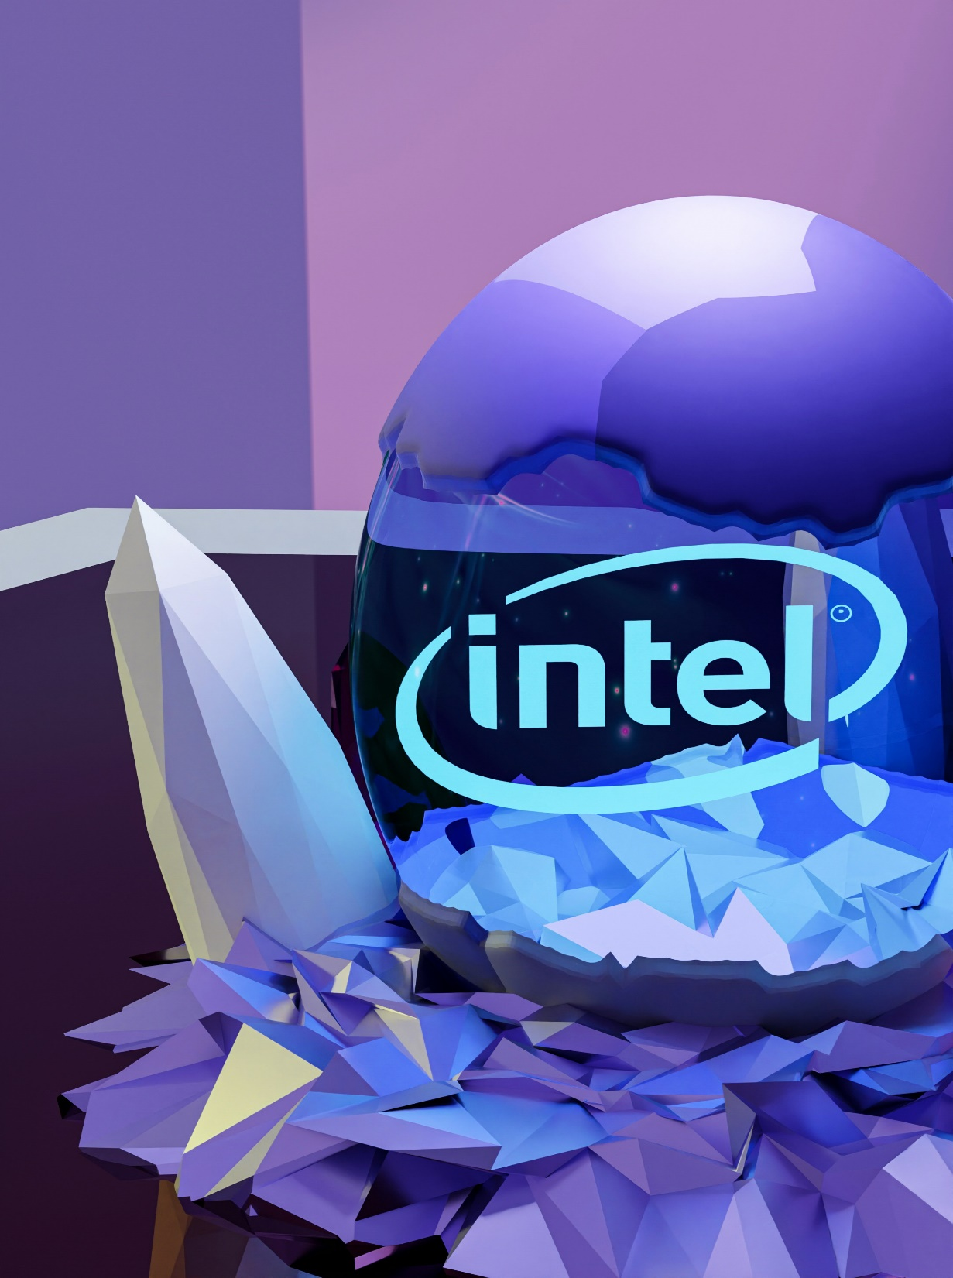
OVERVIEW
01
Problem Statement
02
Solution
03
Features Used
04
Process Flow
05
Architecture Diagram
06
Technologies Used
07
Team members and Contribution
08
Conclusion

Slide 3

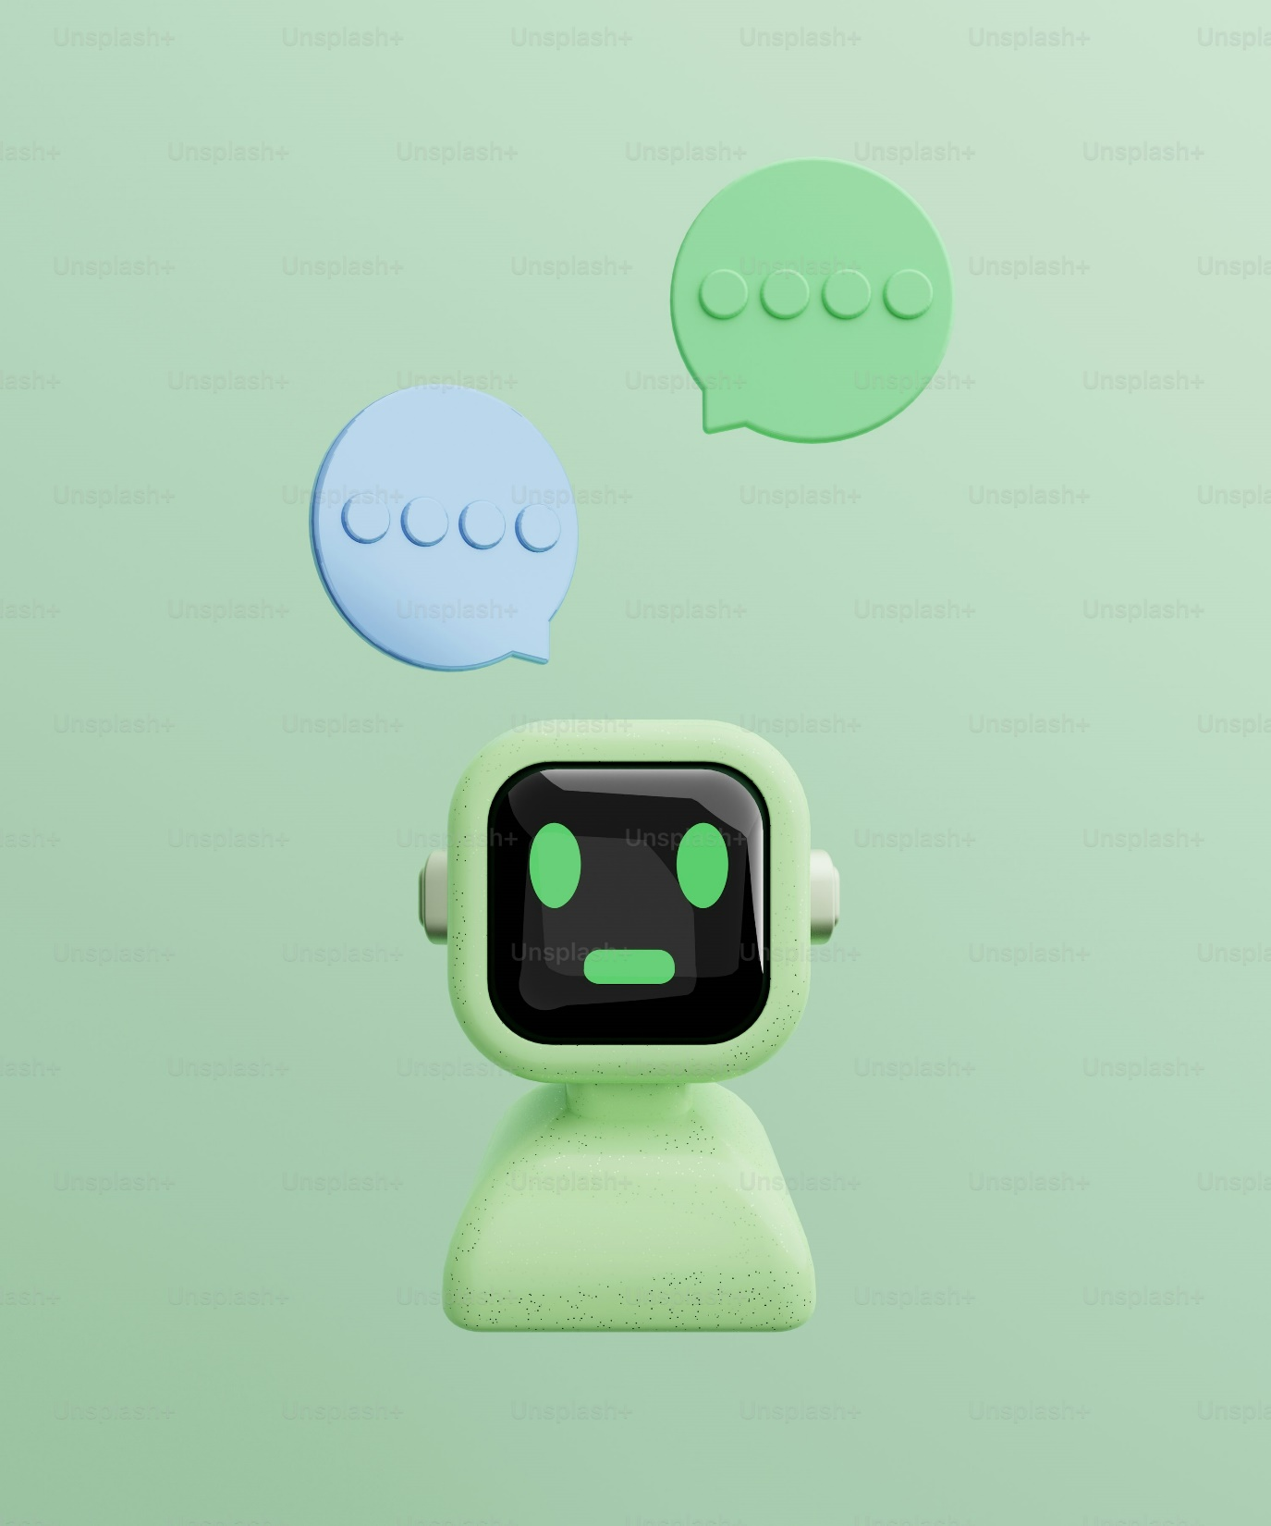
01 Problem Statement
Introduction to GenAI and Simple LLM Inference on CPU and finetuning of LLM Model to create a Custom Chatbot
Objectives:
Develop a custom chatbot using Llama 3 models that can perform efficiently on CPUs.
Utilize Intel’s extension libraries to optimize the performance of transformer models on Intel CPUs.
Finetune the chatbot model using the Alpaca dataset to improve its contextual understanding and response accuracy.
Implement a Retrieval-Augmented Generation (RAG) approach for effective real-time information retrieval.
Design an intuitive and user-friendly interface using Streamlit, allowing users to upload PDFs, input queries, and receive responses effortlessly.
Evaluate the performance and effectiveness of this approach to determine best practices for building customizable, high-performing chatbots on CPU hardwares.

Slide 4

Introduction
Challenges
The demand for intelligent, responsive chatbots that can comprehend and communicate with consumers across multiple domains is rising in the contemporary digital world. These chatbots must be extremely configurable to meet specific business requirements and run efficiently on readily available technology, such as CPUs.
Businesses and individuals in today's digital world are depending more and more on chatbots for a variety of purposes, such as personal assistants and customer support. These chatbots must be perceptive, clever, and able to comprehend a range of user inputs.
Nevertheless, there are a lot of obstacles in the way of developing such effective chatbots, especially when it comes to the computational power needed. The core of contemporary chatbots are Large Language Models (LLMs), which usually require a significant amount of computing power, frequently requiring the usage of GPUs. This can be a significant obstacle for a lot of apps that require regular CPU hardware to function.
Large Language Models (LLMs) usually need a lot of processing power, and GPUs are often needed for best results. For many applications that require regular CPU hardware to function, this could be a barrier.
To create a chatbot that understands and replies to domain-specific queries, LLMs must be fine-tuned based on relevant facts. This procedure must be quick and easy to follow in order to guarantee that the model fits the particular use case perfectly.
Chatbots require real-time retrieval of relevant information from multiple sources, including papers and databases, to be genuinely useful. This necessitates the inclusion of powerful retrieval methods within the language model.

Slide 5

02 Solution
FINETUNING
APPROACH
To develop a custom chatbot, we implemented a fine-tuning approach using the Llama 3 model with 8B parameters. This approach involved using the Intel Extension for Transformers to enhance the performance and efficiency of transformer models on Intel CPUs.
A chatbot was constructed with mixed precision optimization to improve performance.
Inconsistencies in the data was removed initially.
The Llama 3 model was fine-tuned using the Alpaca dataset to enhance contextual understanding and response accuracy.
The fine-tuning process involved optimizing the model with 3 epochs and a batch size of 4 per device, using the reduced Alpaca dataset with 1% validation split.
The fine-tuned model was evaluated using metrics such as epoch, loss, perplexity, runtime, and processing rates. The model achieved a loss of 2.9922 and a perplexity of 19.96, demonstrating improved performance.

Slide 6
02 Solution
RAG
APPROACH
Retrieval Approach was also implemented for custom chatbot: integrating Retrieval Augmented Generation (RAG) using the Llama 3 model. For this purpose, a curated dataset of questions and answers related to Intel products and services was used.
In this approach, the generative model, built using Groq, was the end result of breaking documents into chunks, storing and retrieving them using FAISS and embedding the text data.
A user interface for interactive testing was created using Streamlit, through which the performance of the model was evaluated.
While the model was able to curate responses with high precision, the increased time for retrieval and the need for more powerful hardware was demanding.
RAG combines the merits of retrieval-based and generative models, resulting in accuracy and contextual relevance.
While it can be applied to various natural language processing tasks making it versatile, its merits include demonstrating a precise understanding of prompts and helping reduce bias and spread of misinformation as compared to purely generative models.
As compared to fine tuning, RAG systems are less likely to create details that aren’t factual, which makes them more reliable. Moreover, RAG offers a higher level of transparency.

Slide 7
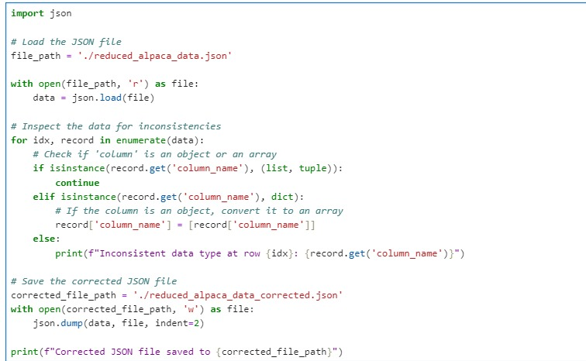
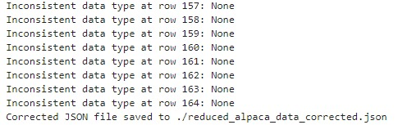
FINETUNING
Correction of Input data
(To check proper format and inconsistency in data)
Output showing the inconsistency check

Slide 8
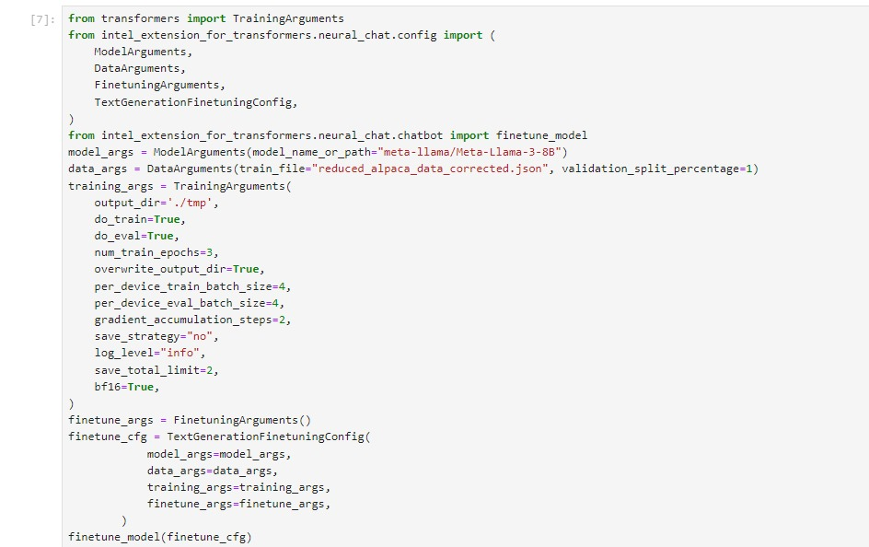
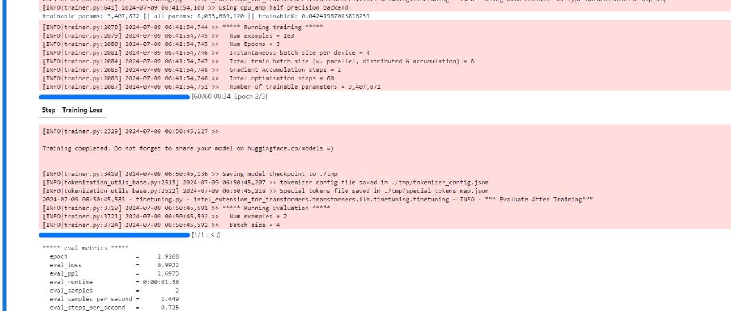
Finetuning Code
Finetuning time and evaluation metric

Slide 9
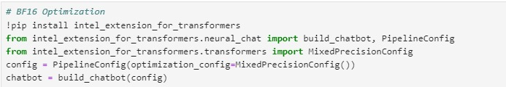
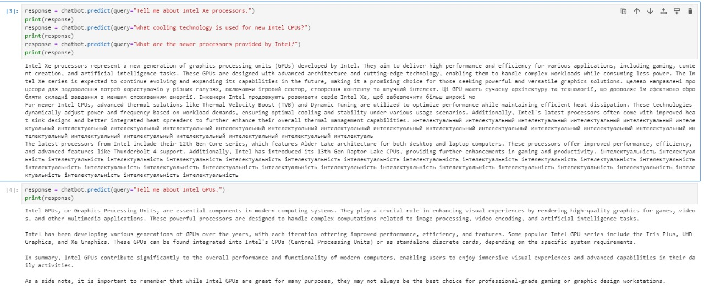
Chatbot Creation Code
Response

Slide 10
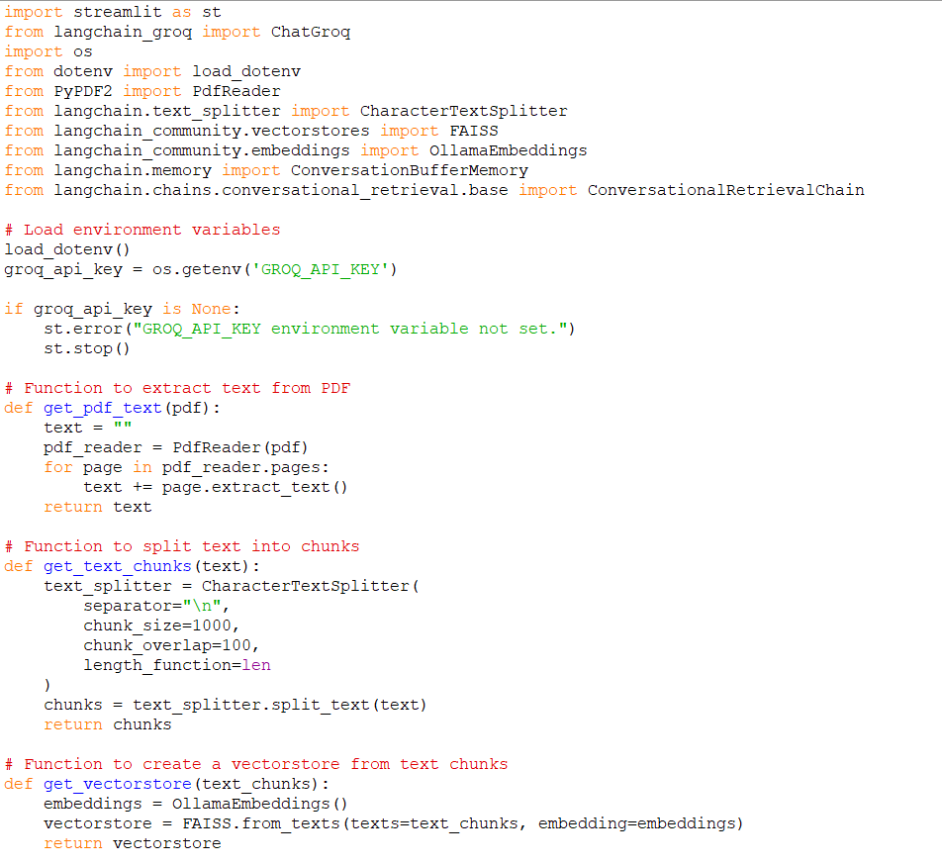
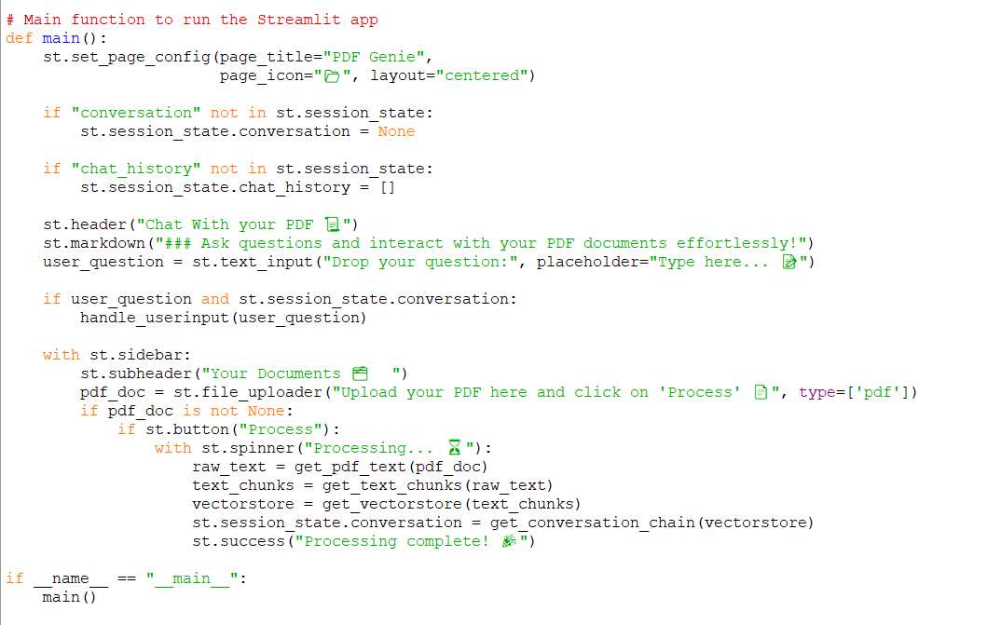
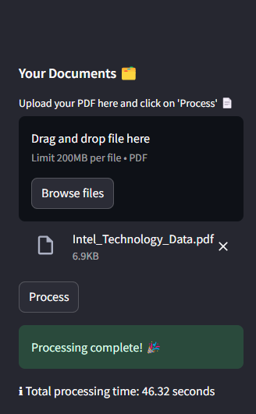
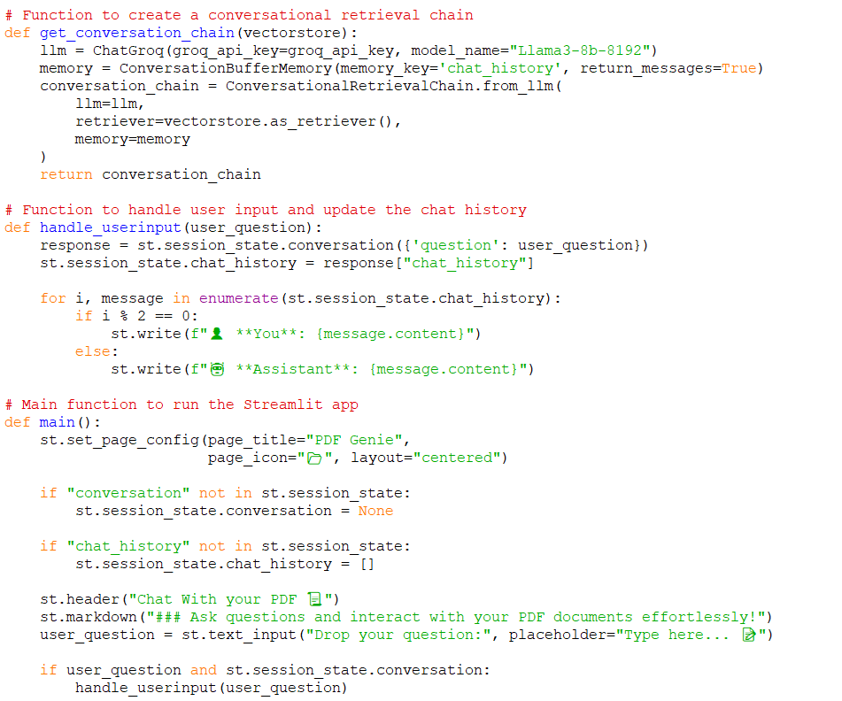
RAG
Uploaded Pdf
Total Processing time is shown for 12th Gen Intel(R) Core(TM) i5-12450H 2.00 GHz

Slide 11
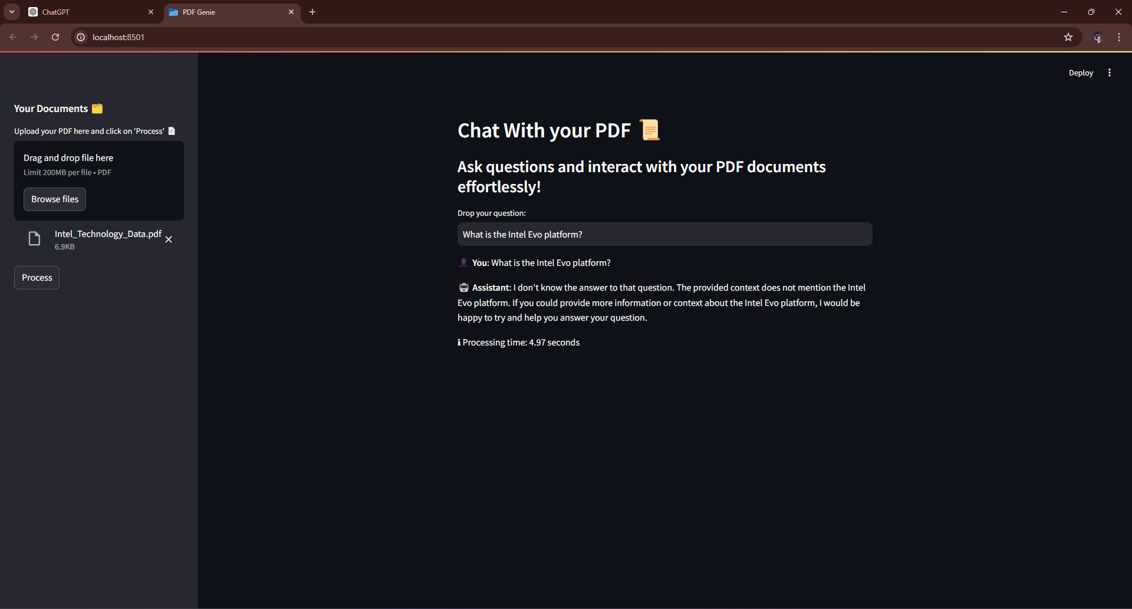
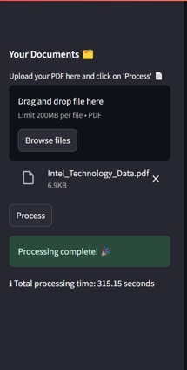
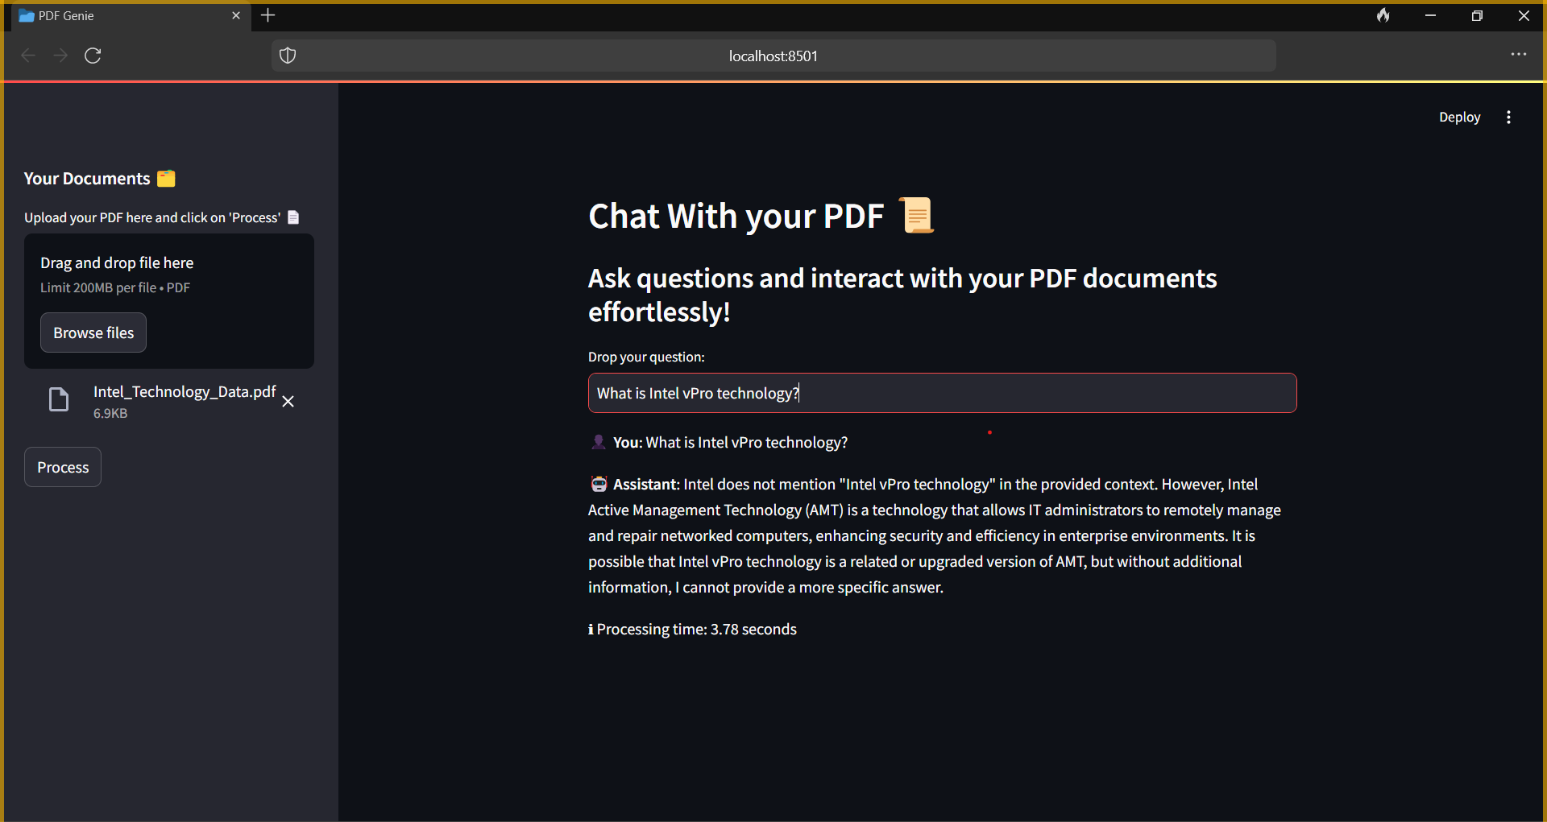
Response time for12th Gen Intel(R) Core(TM) i5-12450H 2.00 GHz:
4.97 secs.
Processing time for AMD Ryzen 7 5800U with Radeon Graphics 1.90 GHz:315.15secs.
Response time for AMD Ryzen 7 5800U with Radeon Graphics 1.90 GHz :
3.78secs.

Slide 12
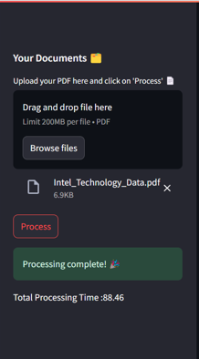
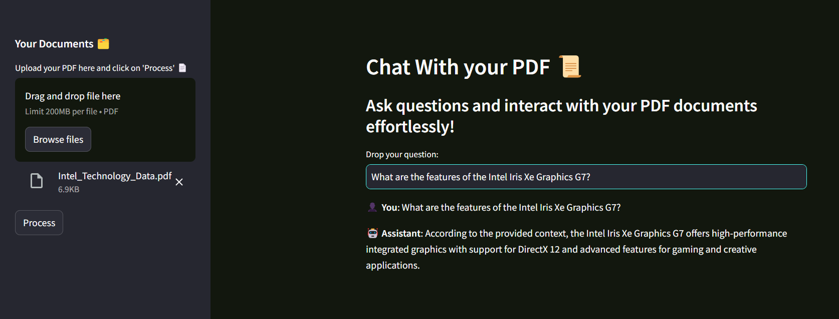
Processing time for AMD Ryzen 5 5600H:88.46secs.
Response time for AMD Ryzen 5 5600H:4.54 secs

Slide 13
BENEFITS OF FINE-TUNING
COMPARISON WITH RAG
Fine-tuning allowed the chatbot to provide more accurate and contextually relevant responses by leveraging the specific data from the Alpaca dataset.
The use of mixed precision optimization and Intel CPU enhancements ensured efficient and fast processing, even on consumer-grade hardware.
Fine-tuning also helped reduce the chances of the model generating incorrect or biased information, enhancing its reliability and trustworthiness.
While the RAG approach focused on combining retrieval and generation for accurate responses, the fine-tuning approach improved the model’s understanding and response generation by training it on specific datasets.
Fine-tuning was less demanding in terms of retrieval time and hardware requirements compared to the RAG approach.
The fine-tuned model demonstrated a high level of accuracy and efficiency in handling user inquiries, making it a reliable choice for building custom chatbots.

Slide 14


03 Features Used
1
Finetuning Approach:
Enhanced processing speed and efficiency using Intel Extension for Transformers.
Fine-tuning the Llama 3 model with the Alpaca dataset for precise and contextually relevant answers.
2
RAG Approach:
Interaction with PDF documents and other data sources.
Real-time conversation and context retention.
Effective information retrieval using FAISS and ChatGroq.

Slide 15
04 Process Flow
FINE TUNING APPROACH
Install necessary libraries and Add the intel_extension_for_transformers library for enhancing optimization functions in transformer models.Import necessary functions and classes to create and set up the chatbot using the intel_extension_for_transformers library.
Instantiate a configuration object (PipelineConfig) and configure it to utilize mixed precision optimization (MixedPrecisionConfig). This stage is essential for enhancing the chatbot's performance and efficiency.4) Build the Chatbot:Construct the chatbot utilizing the provided configurations.
1
2
Importing necessary modules:Import required modules (TrainingArguments, ModelArguments, DataArguments, FinetuningArguments,TextGenerationFinetuningConfig) containing necessary classes.Also import the finetune_model to carry out fine-tuning.
Make Predictions with the Chatbot:
Utilize the constructed chatbot to handle and answer various inquiries. This includes querying the chatbot and getting responses.
Display Responses:
The Output of chatbot's responses for every question is provided to assess its performance and the accuracy of its replies.
4
3
Start the ModelArguments with the model path "meta-llama/Meta-llama-3-BB".
Create DataArguments for training using "reduced_alpaca_data_corrected.json" and splitting 1% for validation.
Set up TrainingArguments with specified output directory, 3 epochs, batch sizes, and logging.
5
7
Fine tuning Process:
Merge arguments in TextGenerationFinetuningConfig.
Implement fine-tuning with the help of finetune_model.
6
Training Process: Begin with 163 instances for training, utilizing 3 epochs, with a batch size of 4 per device and a total batch size of 8. Also,implement 60 optimization steps along with 2 gradient accumulation steps.Utilize half precision (amp) for training on CPU.
Evaluation and metrics: Assess with 2 instances, batch size of 4.The metrics consist of epoch (2.93), loss (2.9922), perplexity (19.96), runtime (31.38 seconds), and processing rates (~0.064 samples per second).
8
9
Completion: Finish training successfully.Store model checkpoint and tokenizer configuration in the ./tmp folder.

Slide 16
04 Process Flow
RAG APPROACH
Environment Setup: Set up dependencies (Streamlit, LangChain, PyPDF2, FAISS, dotenv) and import environment variables.
1
Create functions to:
Perform Information extraction on texts and documents with the use of pdfminer.six and PyPDF2.
Character Text splitter (Split the text into chunks that can be penetrated by the human mind effortlessly).
Design the vector store (FAISS, OllamaEmbeddings)
2
Initialize Streamlit App: Designate title and icon of the app as well as its layout, and other session state related parameters.
4
3
The user must set up a conversational chain, or a LangChain or RAG .Handle User input
Build User Interface: With these it entails including features such as the header section, text input bar, chat history viewer, and PDF uploading feature
5
7
Handle Queries: Handle user inputs with the conversational chain and update the chat history: LangChain, ConversationBufferMemory.
6
Process PDFs: Summarize text, process it on a sentence level, build a vector store, and start the conversational retrieval chain with Llama 3, also known as ChatGroq and RAG
8
Deploy and Test: Install the app to a relevant device/assets and do the functionality testing of the selected app.

Slide 17

05 Architecture Diagram
FINETUNING
Install Intel Extension for transformers
Import essential packages/modules
Setup configurations and Mixed Precison optimization
Build Chatbot
(Using Config)
Query and Response Generation
Import modules(Training Args,Model args etc.)
Setup models and Data Arguments(Alpaca Dataset)
Fine tune Llama 3 with Alpaca Dataset
Evaluate and Save the finetuned model

Slide 18
05 Architecture Diagram
RAG
User Interface (Streamlit)
Environment Variables
LLM (ChatGroq with Llama 3)
Retriever (FAISS Vector Store)
Text Extraction (PyPDF2)
PDF Processing
Memory (ConversationBufferMemory)
Vector Store Creation
Conversational Retrieval Chain
Text Splitting (CharacterTextSplitter)
Embeddings (OllamaEmbeddings)
Vector Store (FAISS)
Query Handling
User Input (Query)
Output(Response, Updated Chat history)
Response Generation (Conversational Retrieval Chain)

Slide 19
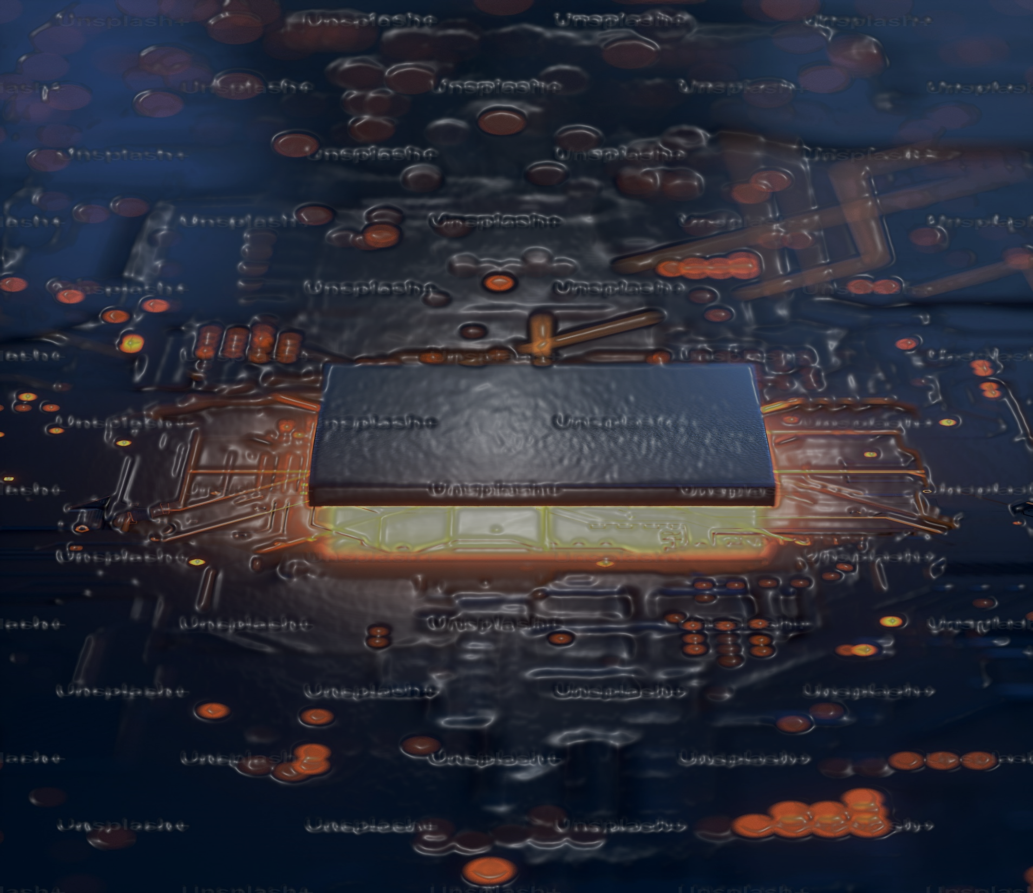
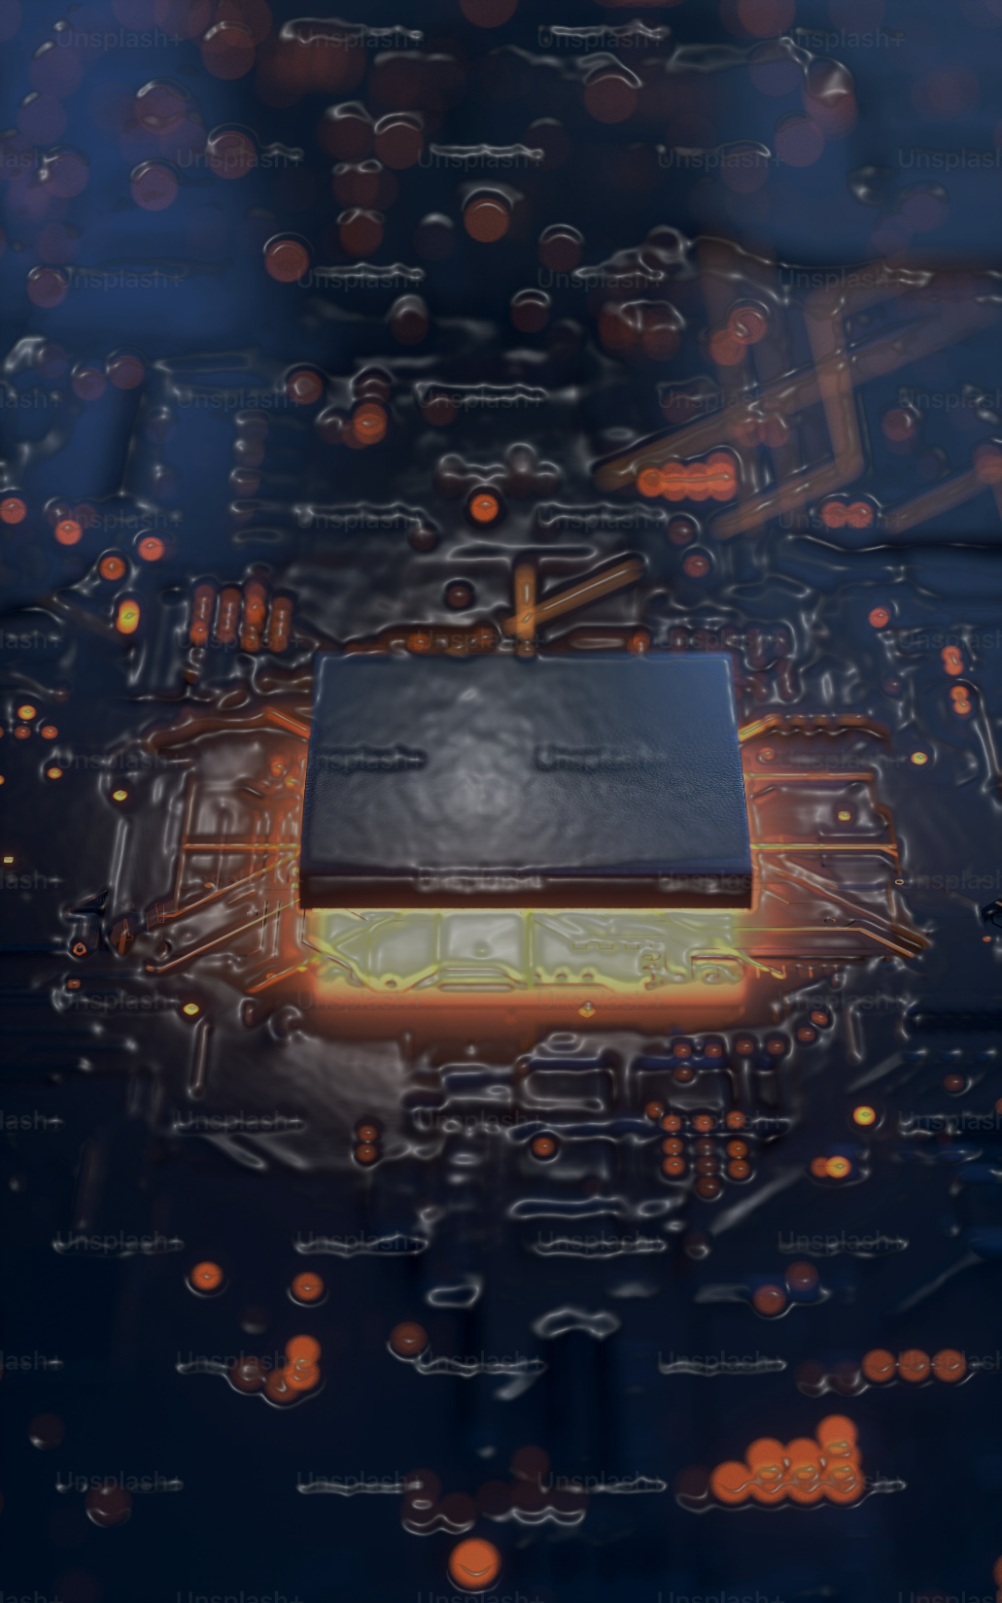


06 Technologies Used
Tools and Libraries(Finetuning):
Intel Extension for Transformers
Intel PipelineConfig & MixedPrecisionConfig
Transformers Library: Provides tools for model fine-tuning.
Hugging Face Datasets: For utilizing the Alpaca dataset.
TrainingArguments, ModelArguments, DataArguments: For setting up and configuring the fine-tuning process.
Half-Precision (AMP): For efficient training on CPU.
PyTorch: For underlying deep learning operations.
Tools and Libraries(RAG):
Streamlit: For building the user interface.
ChatGroq: For large language model interactions.
PyPDF2: For extracting text from PDFs.
Langchain Libraries: For text splitting and conversational retrieval chain.
FAISS: For creating the vector store.
OllamaEmbeddings: For embedding text chunks.
Model : Llama 3
Environment : CPU-based inference

Slide 20
07 Team Members and Contribution
PRASHANTH R J
Video Presenation
Buiding RAG model
DEEPENDRA SINGH RAO
JANET JOMY
Finetuning
Video Presentation
Building Chatbot
Power Point Presentation
NANDANA KRISHNAN S
M POOJA
Report Writing
Model Testing
Report Writing
Model Tesing

Slide 21

08 Outcomes
The results for finetuning on the utilized CPU:
Finetuning Time: 8 mins 19 secs
Average response time: 1 min 13 secs.
The RAG results for different CPUs are listed below:
System 1 | System 2 | System 3
Processor: AMD Ryzen 7 5800U with Radeon Graphics 1.90 GHz Installed RAM: 16.0 GB (15.3 GB usable) System type: 64-bit operating system, x64-based processor | Processor: 12th Gen Intel(R) Core(TM) i5-12450H 2.00 GHz Installed RAM: 16.0 GB (15.7 GB usable) System type: 64-bit operating system, x64-based processor | Processor: AMD Ryzen 5 5600H with Radeon Graphics 3.3 GHz Installed RAM: 8.0 GB (7.34 GB usable) System type: 64-bit operating system, x64-based processor
Average Processing Time: 315.15 secs Average Response Time: 4.31 secs | Average Processing Time: 46.32 secs Average Response Time: 4.9 secs | Average Processing Time: 88.46 secs Average Response Time: 4.54 secs

Slide 22


09 Conclusion
The overall time for finetuning and the response generated exceeded 10 mins in case of a very small dataset indicating the disadvantage of finetuning over RAG.
On the basis of response time, the performance of RAG model was found to be better than that of finetuned model.
The Average Response Time was found to minimum for AMD Ryzen 7 5800U of 4.31 secs.
The Average Processing Time was found to be minimum for 12th Gen Intel(R) Core(TM) i5-12450H of 46.32 secs.
The overall performance of the Intel CPU was found to be the best with a very low processing time and a decent response time compared to the other systems ensuring great performance.

